Slide 1
Security (and Starting OS/Files)
Discussion Question: What operating system do you use? What is the job of the operating system? (that you think)

Slide 2
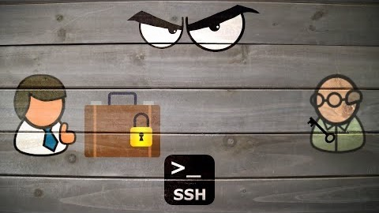
SSH – a quick how it works

Slide 3
Why SSH?
We are going to be spending the next few weeks after the midterm
  Talking about file systems
  Learning Linux
SSH installed on your own machine
  Gives you access to CS Machines
You will learn many tools in your CS career
  This one is used everywhere!
Let’s look at options.

Slide 4
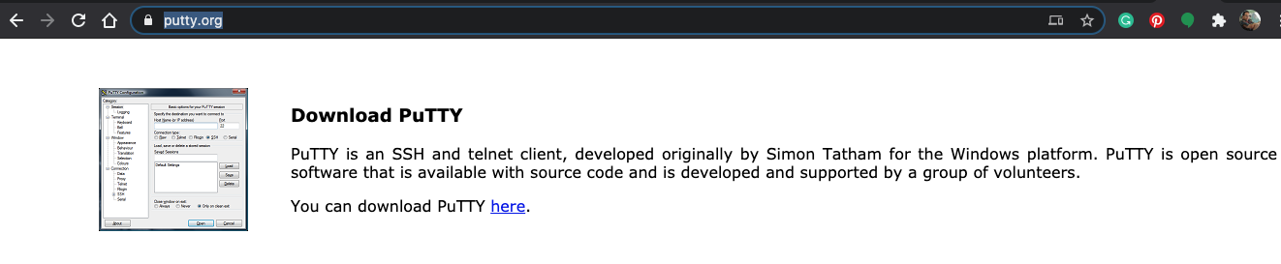
Installing On Local Machine (Client!)
Ask a TA for help installing!
Mac OS / Linux
  You already have it. Open up the terminal
    To find the terminal type ⌘ + spacebar
    Type in “terminal” in the spotlight bar that pops up
Windows
  OpenSSH Terminal
    Built into Windows 10
    type cmd or terminal in the run menu on Windows
    type ssh.exe to see if it is enabled
  MobaXTerm
    Allows easy file transfer between remote and local machine
    Allows you to open applications without setting up xterm tunnel
  Putty.exe
    popular alternative
    https://www.putty.org/
    download for windows
  WSL (Windows Subsystem for Linux)
    Simulates Linux on Windows
    https://docs.microsoft.com/en-us/windows/wsl/install-win10
    Follow manual steps

Slide 5
Connecting To A Server
Any CS machine you have access to
  Is a server you can connect to!
  https://www.cs.colostate.edu/~info/machines
    List of machines. Some popular ones
    denver
    cheyenne
    boston
The machine address is *name*.cs.colostate.edu
  denver.cs.colostate.edu
  boston.cs.colostate.edu
To connect
  > ssh ename@denver.cs.colostate.edu
  > ssh ename@boston.cs.colostate.edu
Go ahead and connect to a
CS server now!

Slide 6
Some Commands
ls
  Lists the contents of a directory
mkdir cs163
  creates a directory cs163
cd cs163
  changes your location to be cs163
pwd
  present working directory – echos to the terminal which directory you are currently in
nano
  Opens a simple text editor (based on pico). You should do this one now
We will go over all these again!!

Slide 7
Coding Practice
> javac HelpSession7.java
compiles your class
> java HelpSession7
runs your java program
Five minutes
  in nano
  Write a java file from scratch
    Call the class HelpSession7
    Which means your file name is??
  Add a main method
    Create a String array, that contains “denver”, “boston”, “portland”
    For each item in the array, print with a new line to the screen, the item followed by “cs.colostate.edu”
      denver.cs.colostate.edu
      boston.cs.colostate.edu
      portland.cs.colstate.edu
Work with a partner on finishing it after five minutes
TA will go over solution
  And show you how to run it *from the command line*

Slide 8
File Input and Scanners - A Deep Dive
Scanner scnr = new Scanner(System.in);
  This code is familiar, but what is it actually doing?
  A Scanner is an object that can parse strings and numbers from a block of text
  System.in is an input stream provided by the system
    Here, an input stream is a flow of data from the user to the computer through the keyboard
Scanner scnr = new Scanner(new File(filename));
  Scanners can parse strings and numbers from other text sources as well
  A File is an information source that lives on the computer and is stored under a filename
  Create a new File with the filename as the parameter to access the file in your program
  Use a Scanner to parse the File after accessing

Slide 9
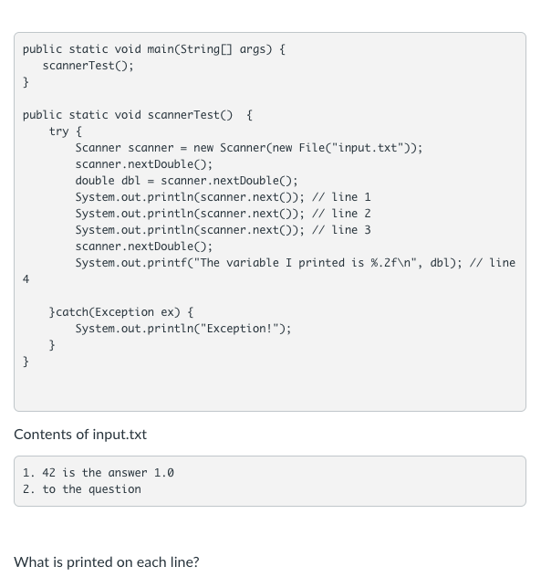
Knowledge Check
Notes:
Note: for the coding example to work, you *have* to use a file. You can’t just try it by passing in a string or using System.in – that changes the end of line that a file has.

